Slide 1

NETWORKING FOR BIG DATA AND LABORaTORY
Francesco Lauro 1706784
Michele Luca Puzzo 1783133

Slide 2
General Information
Some available statistics by Capinfos
File name | _00000_20190410070000.pcap
File type | Wireshark\...-pcapng
File encapsulation | Ethernet
File timestamp precision | microsecond(6)
Packet size limit | file hdr: (not set)
Packet size limit | inferred: 34 bytes - 96 bytes (range)
Number of packets | 1000k
File size | 98MB
Data size | 1099MB
Capture Duration | 3,637099 seconds
First packet time | 2019-04-10 - 07:00:00,056001
Last packet time | 2019-04-10 - 07:00:03,693100
Data byte rate | 302MBps
Data bit rate | 2419Mbps
Average packet size | 1099,84 bytes
Average packet rate | 274kpackets/s

Slide 3
Time Evaluation between Sequential and Parallel reading
 | Time
Sequential reading | 2672.002 seconds
Parallel reading splitting the pcap trace in 5 smaller pcap trace made by 200,000 pkts | 1047.805 seconds
Parallel reading splitting the pcap trace in 10 smaller pcap trace made by 100,000 pkts | 530.910 seconds
Parallel reading splitting the pcap trace in 20 smaller pcap trace made by 50,000 pkts | 474.921 seconds
Parallel reading splitting the pcap trace in 100 smaller pcap trace made by 10,000 pkts | 499.204 seconds
Best performance of parallel reading is 5.63 faster than sequential one!

Slide 4
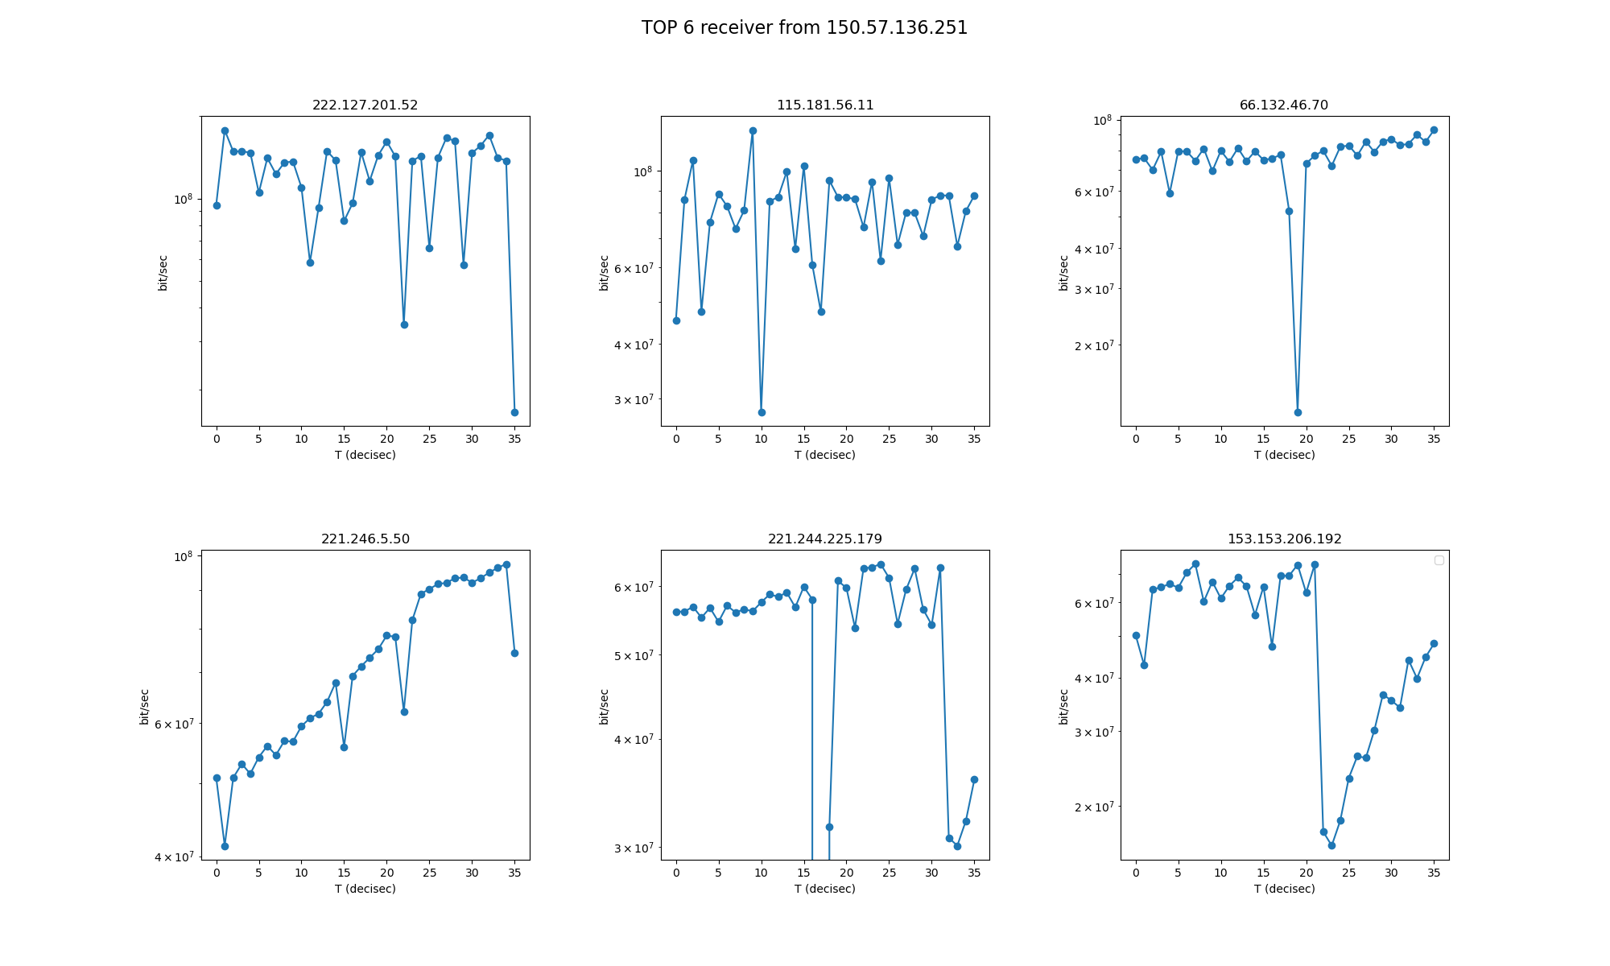
Note: In the fifth plot the seventeenth value is equal to zero bit/sec, for this reason it cannot appear in the log scale plot.

Slide 5
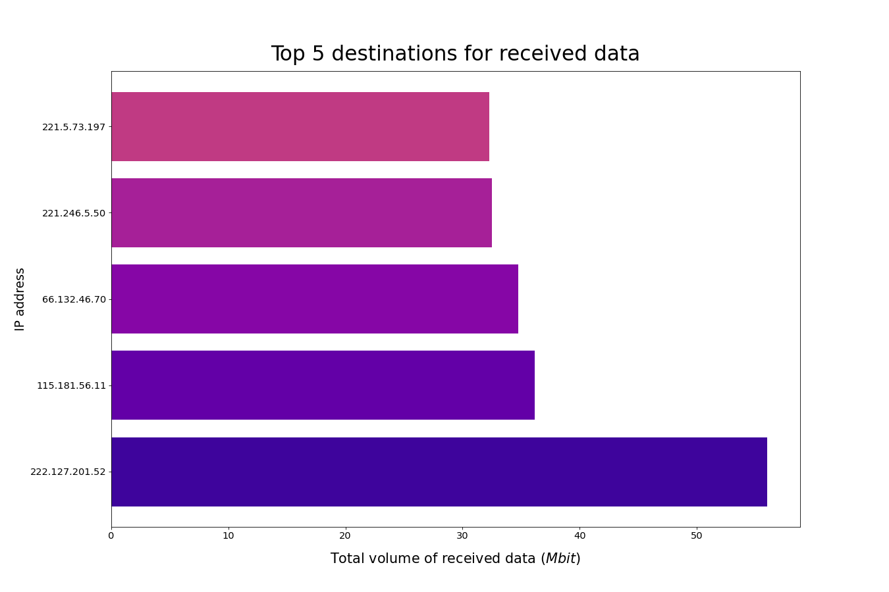
Code:
dataFrame.groupby(["IP_DST"])[['length']].agg('sum’).
sort_values(by=['length'], ascending=False).head(5)

Slide 6
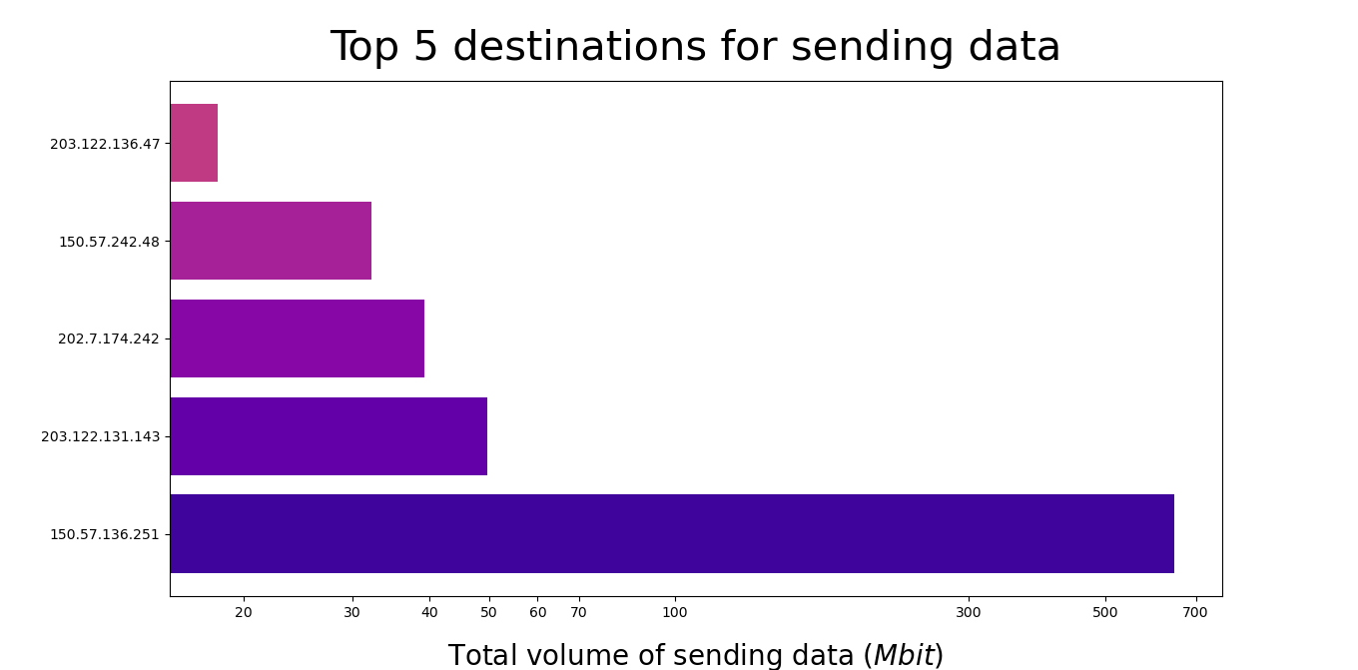
Code: dataFrame.groupby(["IP_SRC"])[['length']].agg('sum').sort_values(by=['length'], ascending=False).head(5)

Slide 7
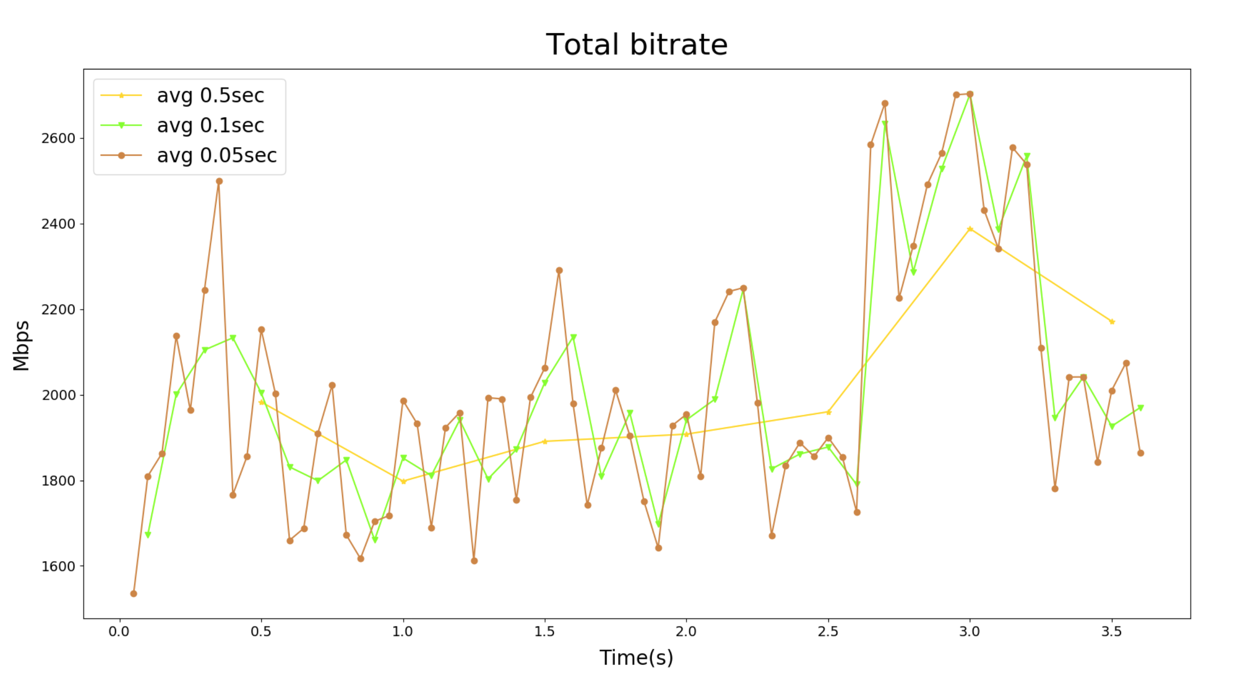

Slide 8
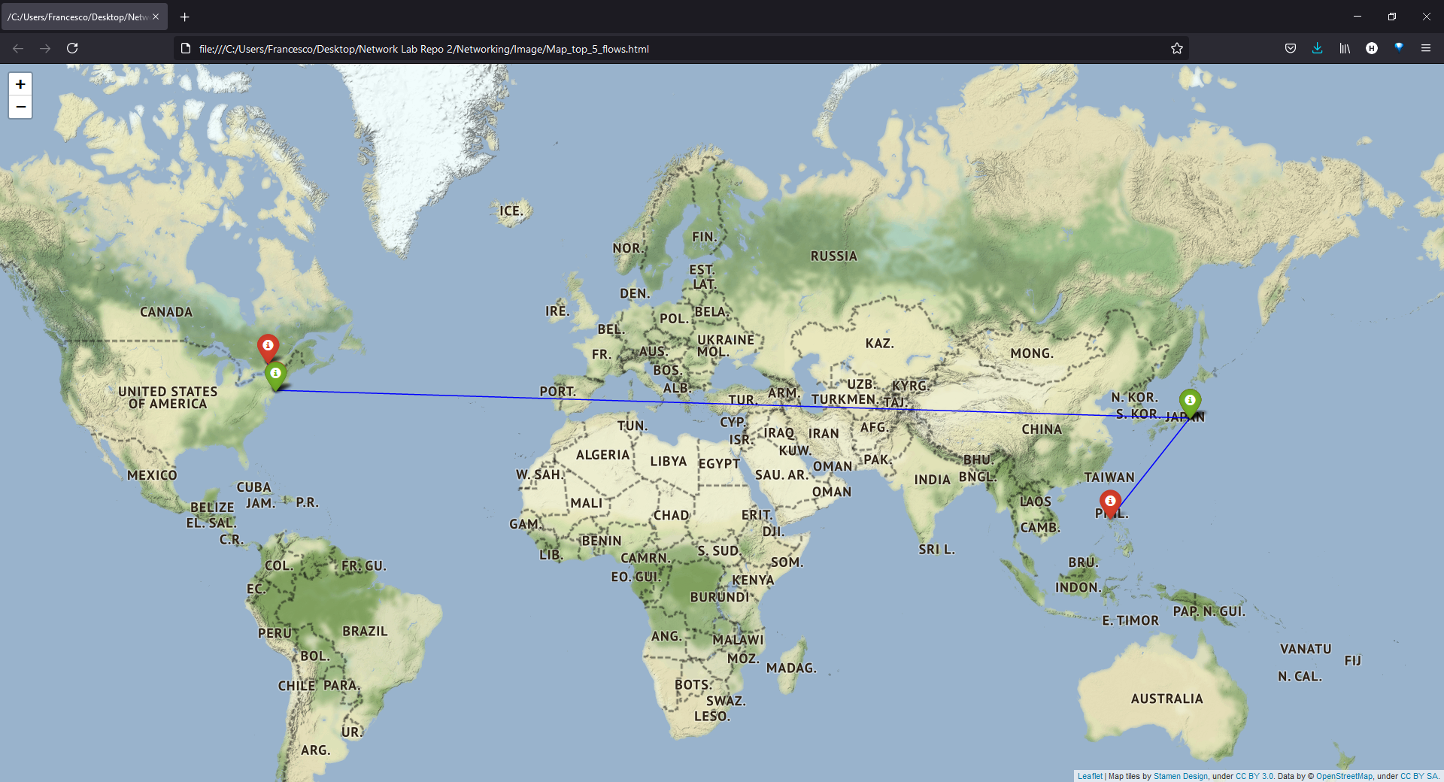
GeoLocal Referenciation of the 5 sessions with the highest amount of traffic generated

Slide 9
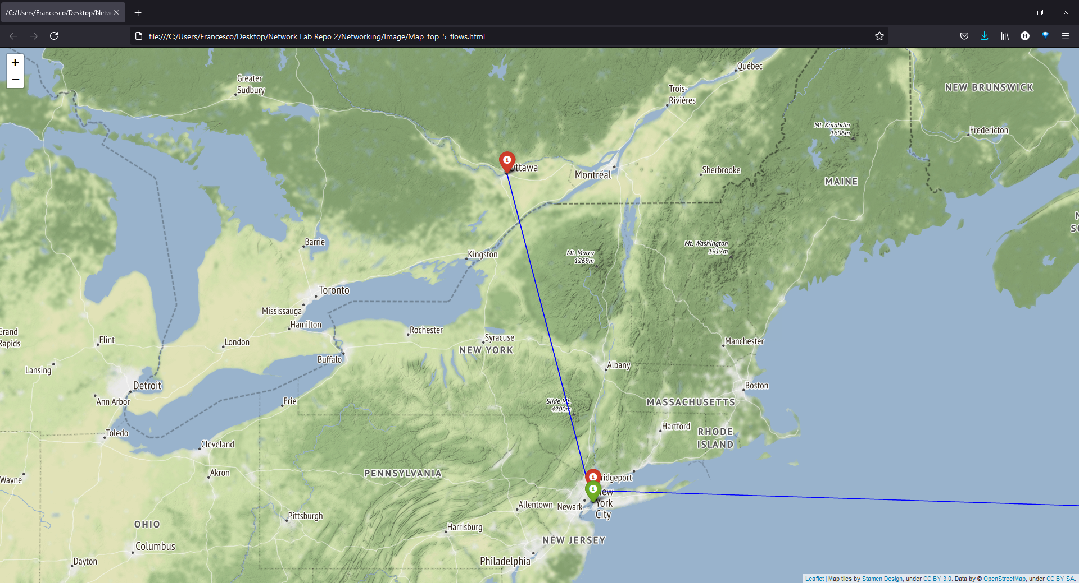

Slide 10
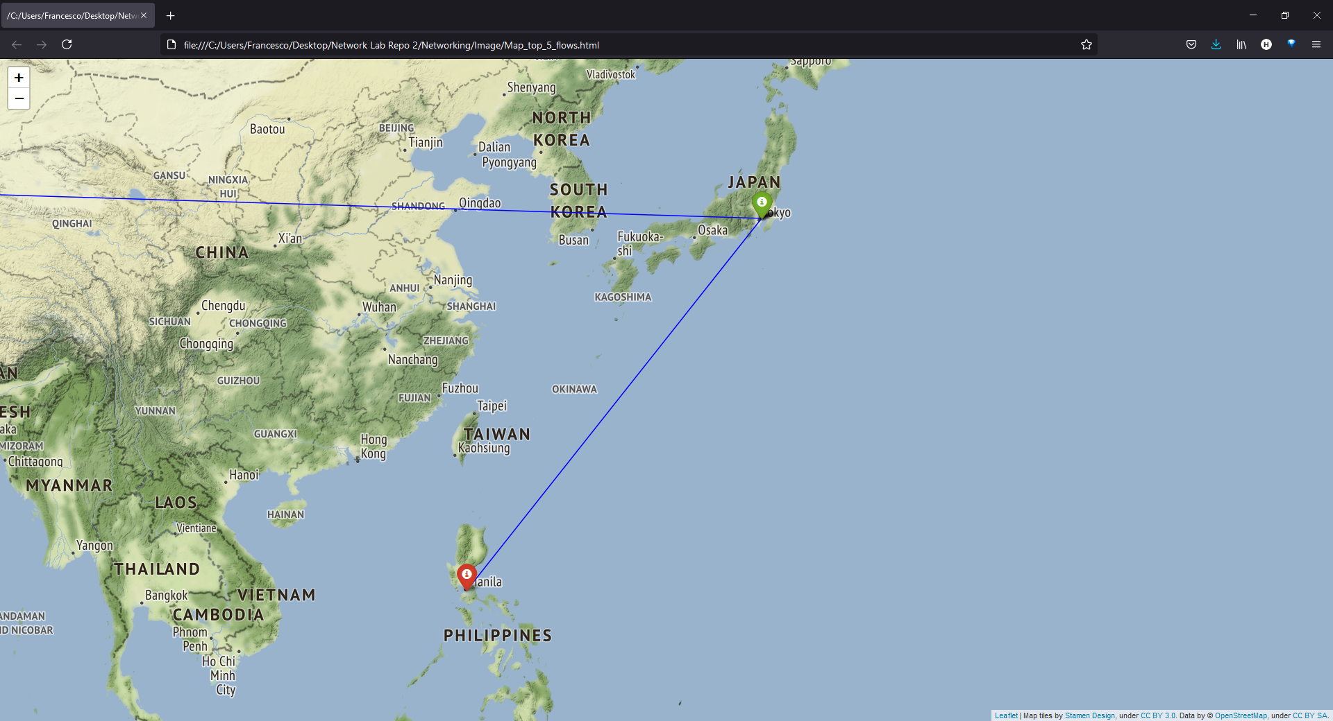

Slide 11
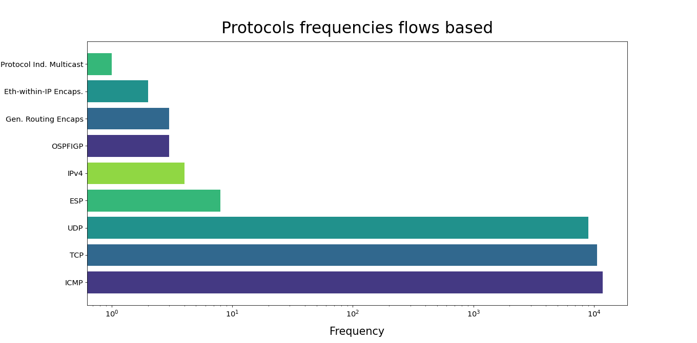

Slide 12
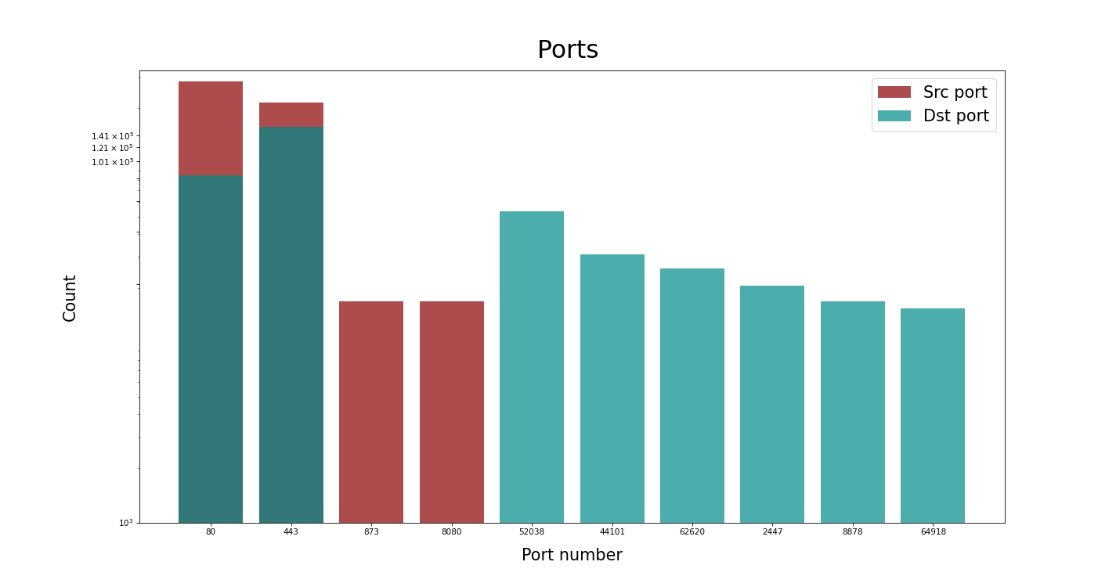

Slide 13
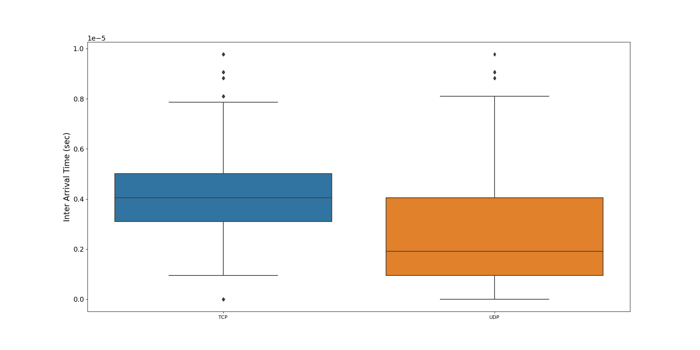
InterArrival Time boxplot between TCP and UDP Sessions

Slide 14
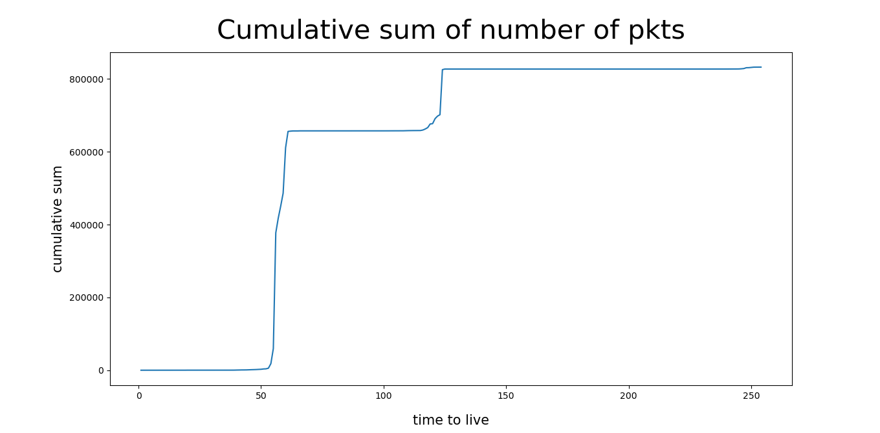
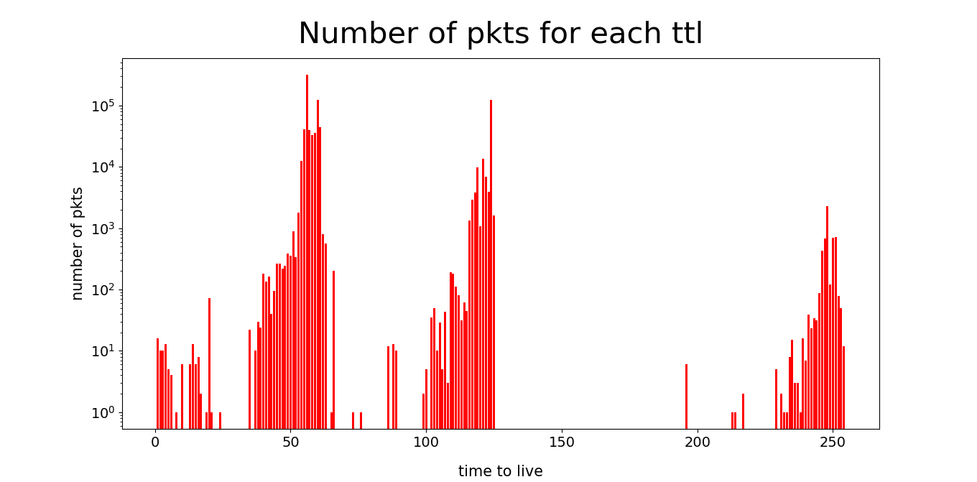
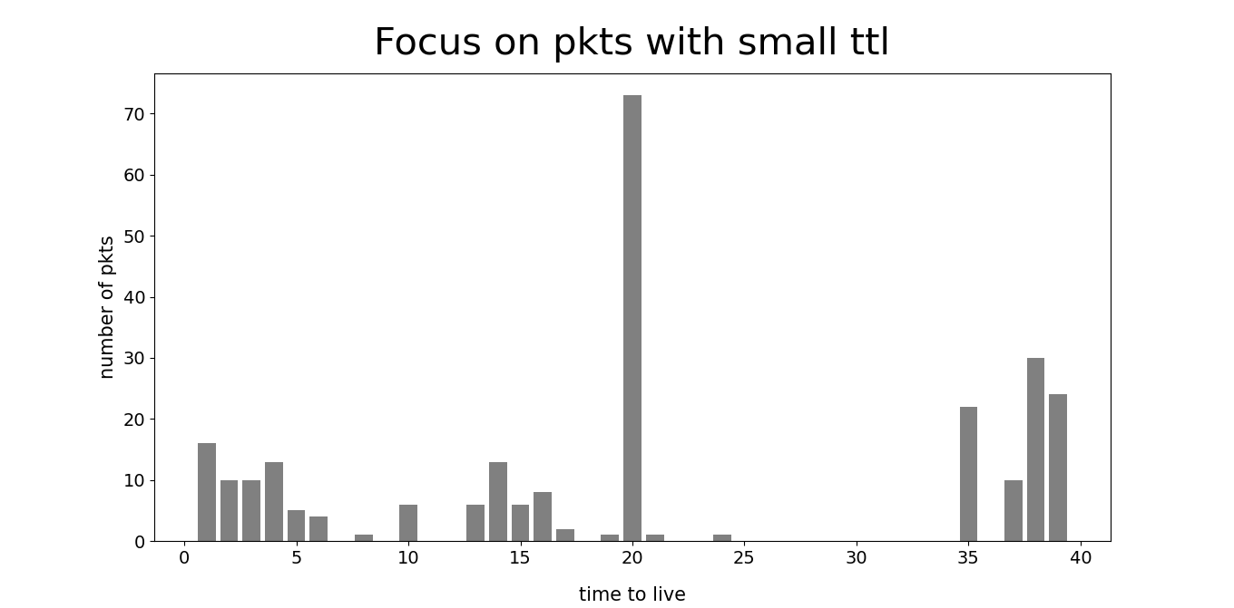
Evaluation about TTL

Slide 15
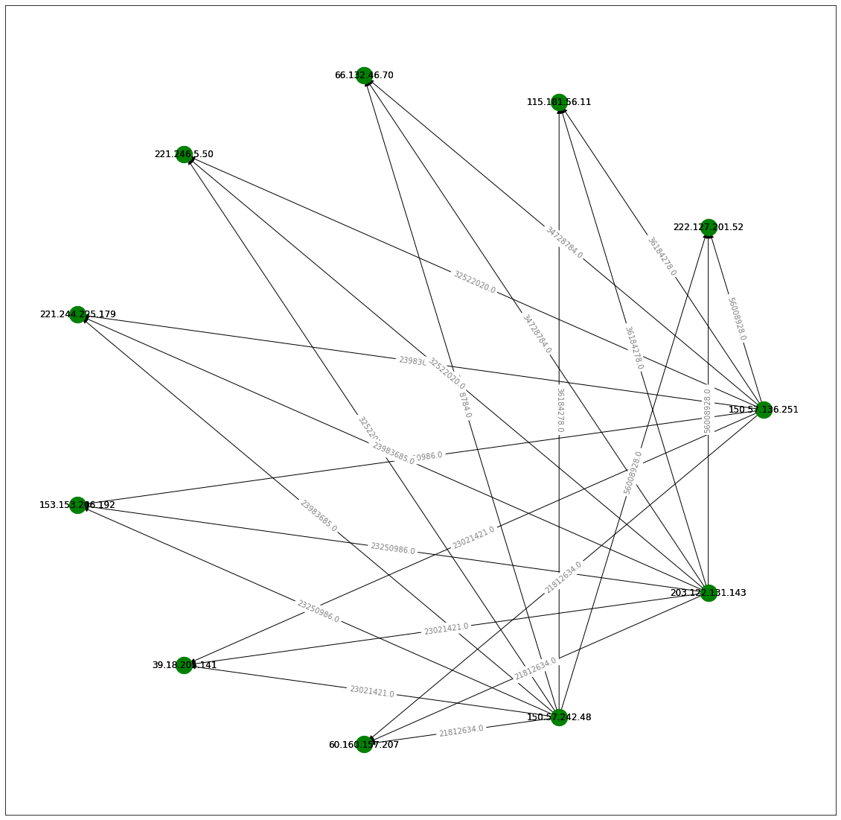
Topology of the network using networkx
Code:
df.groupby(["IP_SRC","IP_DST"])[["length"]].agg('sum’).
sort_values(by=["length"],ascending= False)

